Slide 1
IMAGE ENHANCEMENT Histogram Processing

Slide 2
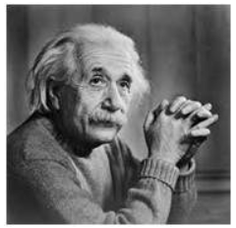
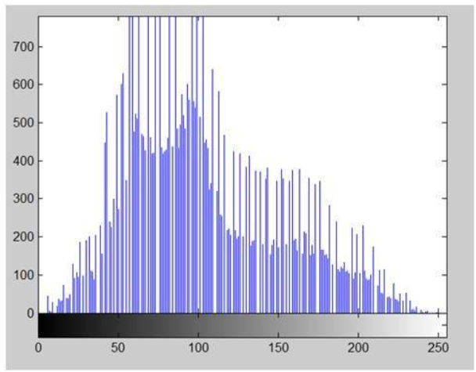
Histogram
Intensity value distribution of pixels
Distribution of pixel brightness
Ex: 500 pixels have a grayscale value of 50

Slide 3
Histogram
The histogram of an image shows us the distribution of grey levels in the image
Massively useful in image processing, especially in segmentation
Frequencies
Grey Levels

Slide 4
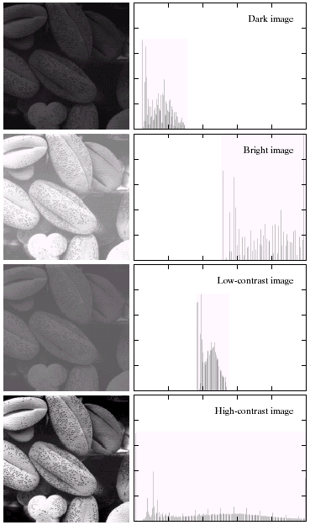
Histogram Examples
A selection of images and their histograms
Notice the relationships between the images and their histograms
Note that the high contrast image has the most evenly spaced histogram

Slide 5
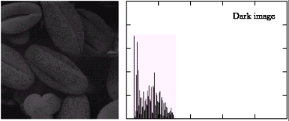
Histogram Examples
The pixel intensities are concentrated in the low end of the grayscale spectrum.
Since the image is dark, the variation in brightness will be limited. This means most pixel values will be clustered together in a smaller range of grayscale values, rather than being spread out across the entire spectrum.

Slide 6
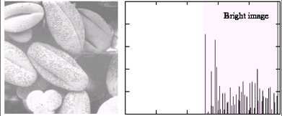
Histogram Examples
The pixel intensities are concentrated in the high end of the grayscale spectrum.
Since the image is bright, there will be more variation in brightness compared to a dark image. This means the pixel values will be spread out across a larger range of grayscale values..

Slide 7
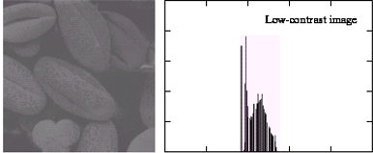
Histogram Examples
Low contrast means the difference between light and dark areas in the image is minimal.
Due to the lack of significant variations in brightness, the pixel values will be clustered in a smaller portion of the grayscale spectrum. They won't be spread out across the full range from black (0) to white (255).

Slide 8
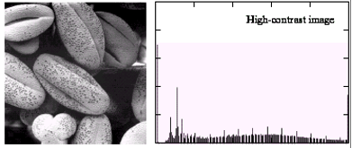
Histogram Examples
High contrast signifies a significant difference between the light and dark areas in the image
To represent this stark difference, the pixel values will be spread out across a larger portion of the grayscale spectrum. There will be a greater presence of both high (bright) and low (dark) values compared to a low contrast image.

Slide 9
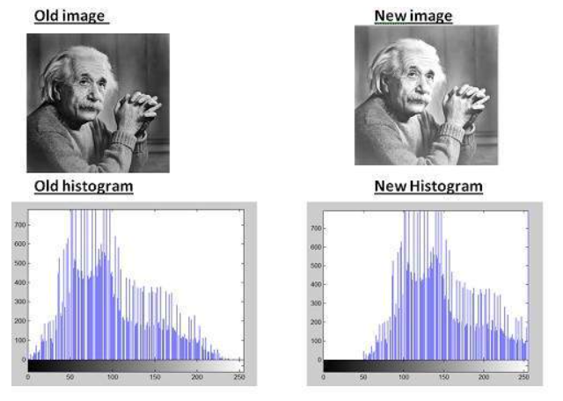
Histogram Sliding
simply shift a complete histogram rightwards or leftwards. Due to shifting or sliding of histogram towards right or left, a clear change can be seen in the image
Simply add 50 to each pixel value
To obtain a brighter image
all the pixel values have been shifted towards right

Slide 10
Histogram Sliding
simply shift a complete histogram rightwards or leftwards. Due to shifting or sliding of histogram towards right or left, a clear change can be seen in the image
Simply add 50 to each pixel value
To obtain a brighter image
all the pixel values have been shifted towards right

Slide 11
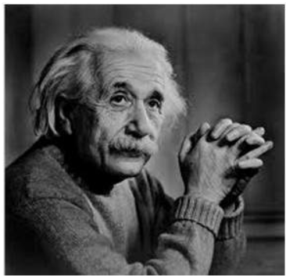
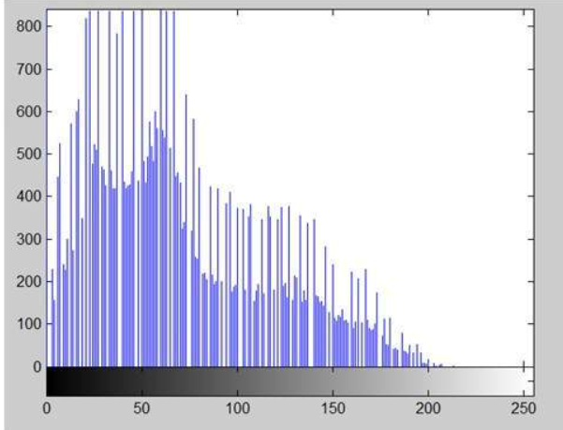
Histogram Stretching
→ contrast enhancement
Contrast?
difference between maximum and minimum pixel intensity
Contrast = 225.

Slide 12
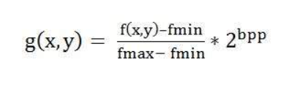
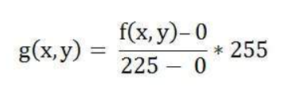
Histogram Stretching
How to increase the contrast?

Slide 13
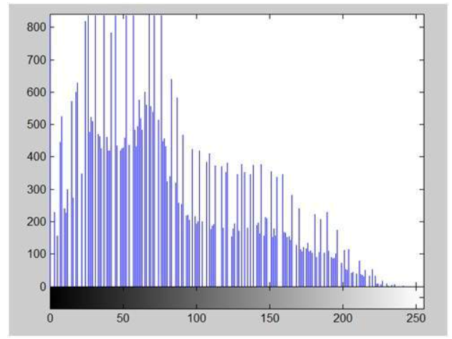
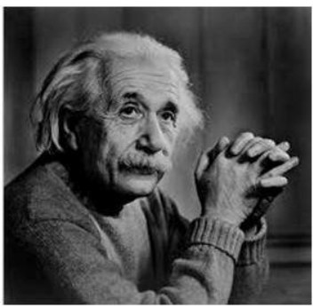
Histogram Stretching
Contrast = 240

Slide 14
Histogram Stretching
Contrast = 225
Contrast = 240

Slide 15

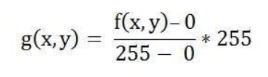


Histogram Stretching
When to FAIL?
when pixel intensities 0 and 255 are present in an image, then they become the minimum and maximum pixel intensity

Slide 16
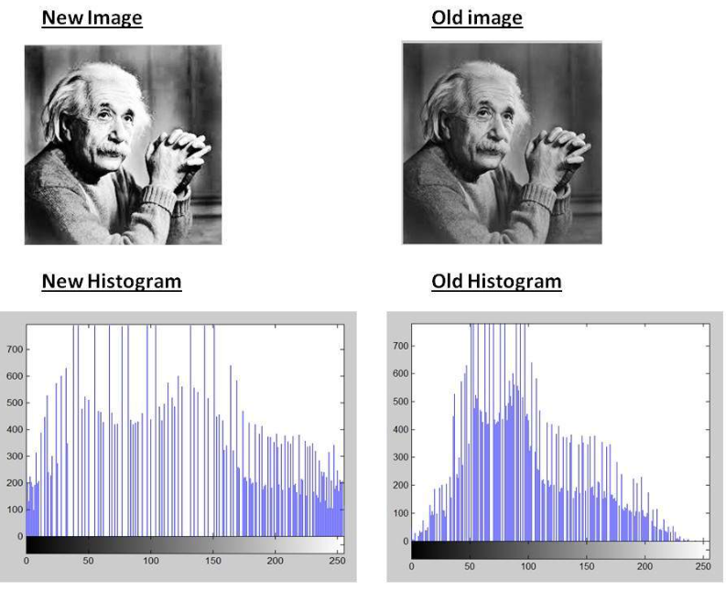
Histogram EQUALIZATION
→ contrast enhancement

Slide 17
Histogram EQUALIZATION
Spreading out the frequencies in an image (or equalising the image) is a simple way to improve dark or washed-out images
The formula for histogram equalization is given where:
r_{k}: input intensity
s_{k}: processed intensity
k: the intensity range (e.g 0.0 – 1.0)
n_{j}: the frequency of intensity j
n: the sum of all frequencies

Slide 18
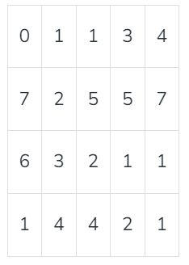
Histogram EQUALIZATION
?

Slide 19
Histogram EQUALIZATION
Probability density function = frequency/#pixels
Cumulative density function = cumulative frequency of each intensity
Value | Frequency | PDF | CDF | CDF*(L-1) | New Value
3-bit image → L=8

Slide 20
Histogram EQUALIZATION
Probability density function = frequency/#pixels
Cumulative density function = cumulative frequency of each intensity
Value | Frequency | PDF | CDF | CDF*(L-1) | New Value
0 | 1 | 0.05 (1/20) | 0.05 | 0.35 | 0
1 | 6 | 0.3 | 0.35 (7/20) | 2.45 | 2
2 | 3 | 0.15 | 0.5 | 3.5 | 4
3 | 2 | 0.1 | 0.6 | 4.2 | 4
4 | 3 | 0.15 | 0.75 | 5.25 | 5
5 | 2 | 0.1 | 0.85 | 5.95 | 6
6 | 1 | 0.05 | 0.9 | 6.3 | 6
7 | 2 | 0.1 | 1 | 7 | 7

Slide 21
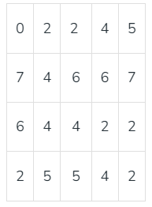
Histogram EQUALIZATION

Slide 22
Difference!
during histogram equalization the overall shape of the histogram changes, whereas in histogram stretching the overall shape of histogram remains same

Slide 23
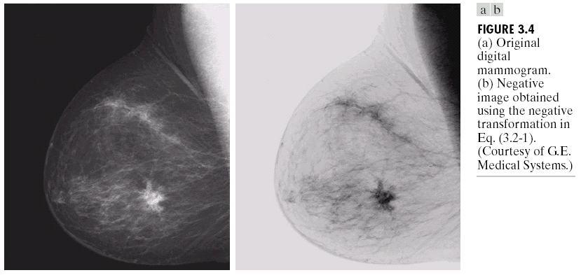
Basic Grey Level Transformations
Negative images
Negative images are useful for enhancing white or grey detail embedded in dark regions of an image
Note how much clearer the tissue is in the negative image of the mammogram
Original Image
255-f(x,y)
Negative Image
For 8bbp

Slide 24
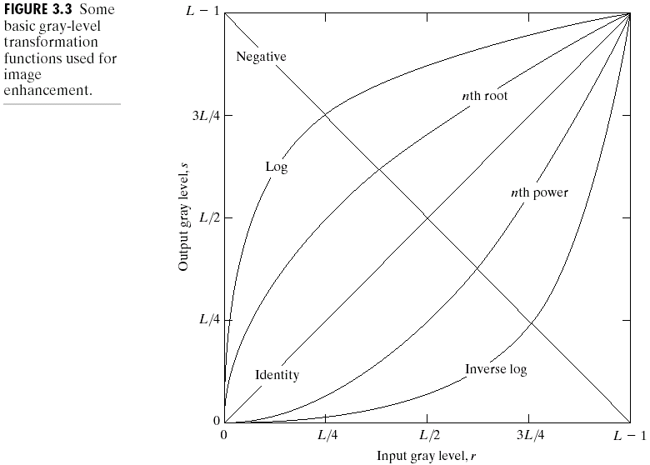
Basic Grey Level Transformations
There are many different kinds of grey level transformations
Three of the most common are shown here
Linear
Negative/Identity
Logarithmic
Log/Inverse log
Power law
n^{th} power/n^{th} root

Slide 25
Basic Grey Level Transformations
The general form of the log transformation is
s = c * log(1 + r)
The log transformation maps a narrow range of low input grey level values into a wider range of output values
The inverse log transformation performs the opposite transformation
Log functions are particularly useful when the input grey level values may have an extremely large range of values

Slide 26
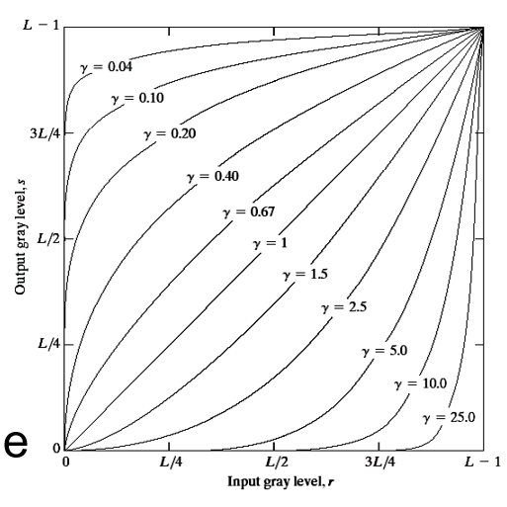
Basic Grey Level Transformations
Power law transformations have the following form
s = c * r ^{γ}
Map a narrow range of dark input values into a wider range of output values or vice versa
Varying ^{γ} gives a whole family of curves

